Slide 1

FACE RECOGNITION ATTENDANCE SYSTEM
Team Members: Supervisor:
NIRANJAN S (621320205033) Dr.N.MAGENDIRAN, M.E.,Ph.D.., Prof/IT
DINESH KUMAR M (621320205301)
RAHUL CR (621320205045)
Date:

Slide 2
TABLE OF CONTENTS
S.NO | TOPICS | PAGE NO
1 | ABSTRACT | 3
2 | INTRODUCTION | 5
3 | LANGUAGE USED IN PROJECT | 6
4 | SYSTEM REQUIREMENTS | 7
5 | EXISTING SYSTEM | 8
6 | PROPOSED SYSTEM | 9
7 | MODULES | 10
8 | SYSTEM ARCHITECTURE | 11
9 | ALGORITHMS | 12
10 | OUTPUT | 13
11 | CONCLUSION | 14
12 | REFERENCE | 15

Slide 3
ABSTRACT
Face recognition system plays a vital role in almost every sector.
It can used for security, authentication, identification, and has got many more advantages Furthermore, face recognition system can also be used for attendance marking in Schools, colleges, offices, etc.
This system aims to build a class attendance system which uses the concept of face recognition as existing manual attendance system is time consuming and cumbersome to maintain.

Slide 4
CONT……
And there may be chances of proxy attendance.This system consists of four phases- database creation,detection, recognition,updation.
Face recognition is a personal identification system that uses personal characteristics of a person to identify the person's identity.
Face recognition is the task of identifying an already detected object as a known or unknown face.

Slide 5
INTRODUCTION
Traditional method of attendance marking is a tedious task in many schools and colleges.
It is also an extra burden to the faculties who should mark attendance by manually calling the names of students which might take about 5 minutes of entire session.
This is time consuming. There are some chances of proxy attendance.
Therefore, many institutes started deploying many other techniques for recording attendance like use of Radio Frequency Identification (RFID) , iris ,recognition , and so on

Slide 6
LANGUAGE USED IN PROJECT
FRONT END:
PYTHON
TKINDER
BACK END:
EXCEL

Slide 7
SYSTEM REQUIREMENTS
HARDWARE REQUIREMENT:
4 GB RAM
256 GB SSD
SOFTWARE REQUIREMENT:
Window 11
Visual studio

Slide 8
EXISTING SYSTEM
Face Recognition Attendance System is being carried out due to the concerns that have been highlighted on the methods which lectures use to take attendance during lectures. This is used for student attendance, but to build a system that will detect the number of faces present in a classroom as well as recognizing them.
Mainly used for student attendance, but to build a system that will detect the number of faces present in a classroom as well as recognizing them.

Slide 9
PROPOSED SYSTEM
The task of the proposed system is to capture the face of each student and to store it in the database for their attendance.
The face of the student needs to be captured in such a manner that all the feature of the students' face needs to be detected, even the seating and the posture of the student need to be recognized.
There is no need for the teacher to manually take attendance in the class because the system records a video and through further processing steps the face is being recognized and the attendance database is updated.

Slide 10
MODULES
Pre-Processing
Face Recognition in real time
Face detection
Face analysis
Converting the image to data
Finding a match.

Slide 11
MODULES
Pre processing
Image preprocessing is the steps taken to format images before they are used by model training and inference. This includes, but is not limited to, resizing, orienting, and color corrections
. Face Recognition
Facial recognition is a way of identifying or confirming an individual's identity using their face. Facial recognition systems can be used to identify people in photos, videos, or in real-time.

Slide 12
MODULES
Face Detection
An artificial intelligence (AI) based computer technology used to find and identify human faces in digital images.
. Face analysis
An intersection between computer vision, Machine Learning and Image processing fields that aims to extract any kind of information from human face except his/her identity such as emotion, engagement, vitals measurement, age and gender.

Slide 13
MODULES
Converting the image to data
The data set used to locate the registered faces is known as the conversion of the image into data.
Finding a match
The accurate detection of the face requires identifying the match corresponding to the registered face in the data set.

Slide 14
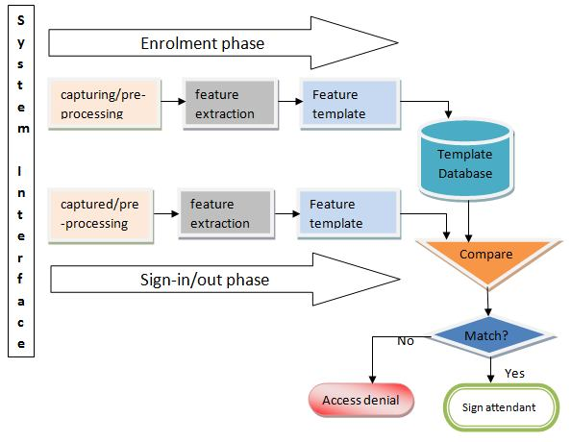
SYSTEM ARCHITECTURE

Slide 15
ALGORITHM
1. Haar-Cascade classifier:
Faces are detected and recognized from live streaming video of the classroom. Attendance will be mailed to the respective faculty at the end of the session.
STEP 1: Importing OpenCV
STEP 2: Importing XML file
STEP 3: Importing test Image
STEP 4: Converting the image to greyscale
STEP 5: Detecting Multi-scale faces
STEP 6: Mentioning sides of the rectangle for face detection
STEP 7: Displaying the detected image

Slide 16
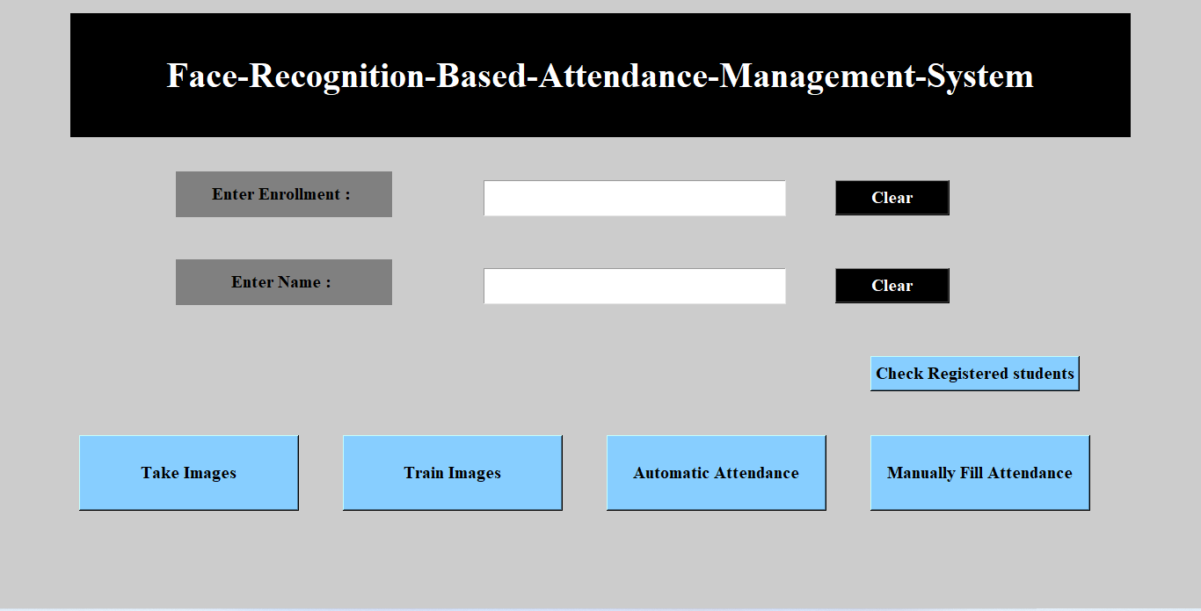
OUTPUT

Slide 17
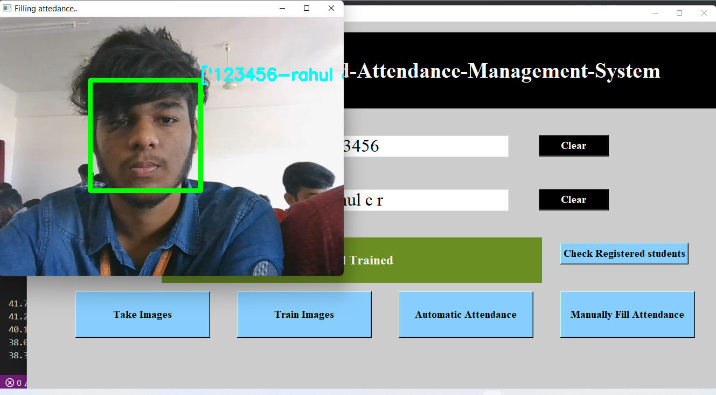
OUTPUT

Slide 18
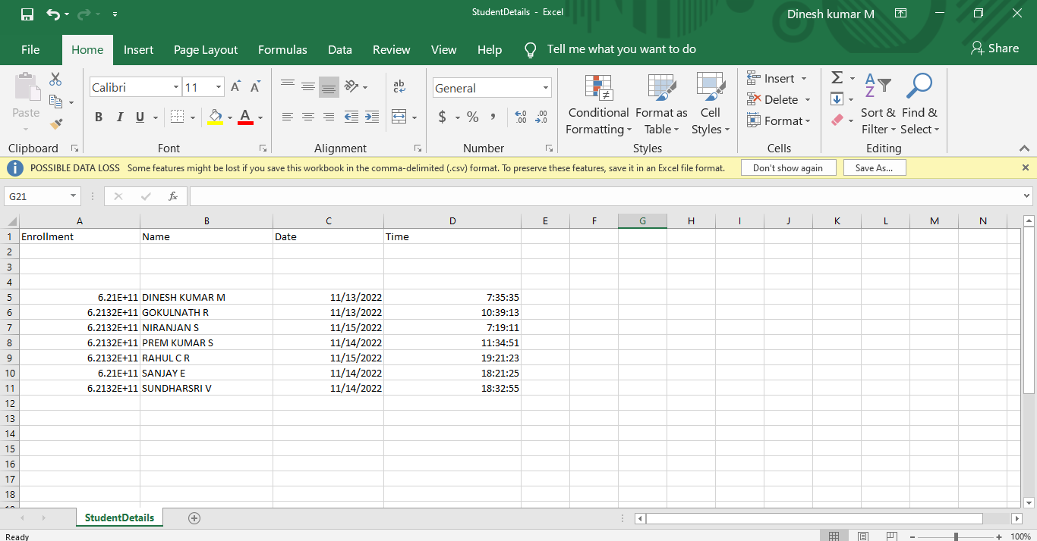
OUTPUT

Slide 19
CONCLUSION
It was a wonderful experience working on Face Recognition Attendance System with enthusiastic and like-minded people where in we explored a part of Artificial Intelligence.
The main working principle of the project is that, the video captured data is converted into image to detect and recognize it.
Further the recognized image of the student is provided with attendance, else the system marks the database as absent.

Slide 20
REFERENCES
REFERENCES
[1] Akbar, Md Sajid, et al. "Face Recognition and RFID Verified Attendance System." 2018 International Conference on Computing, Electronics & Communications Engineering (iCCECE). IEEE, 2018.
[2] Lukas, Samuel, et al. "Student attendance system in classroom using face recognition technique." 2016 International Conference on Information and Communication Technology Convergence (ICTC). IEEE, 2016.
[3] Okokpujie, Kennedy O., et al. "Design and implementation of a student attendance system using iris biometric recognition." 2017 International Conference on Computational Science and Computational Intelligence (CSCI). IEEE, 2017.

Slide 21
.
Thank you…!

